Slide 1
Modern Web Testing: Going Beyond Selenium
Dmitry Vinnik, @DmitryVinnik
Lead Software Engineer, Salesforce

Slide 2
Goals
What are our goals?
End-to-End Testing:
What, Why, How and When
Looking Beyond Selenium WD
Find Right E2E Tool For Your Team
Notes:
Not how to, but why (not step-by-step instructions, there are 100s of those)

Slide 3
How do we usually test?
Let’s go in more details

Slide 4
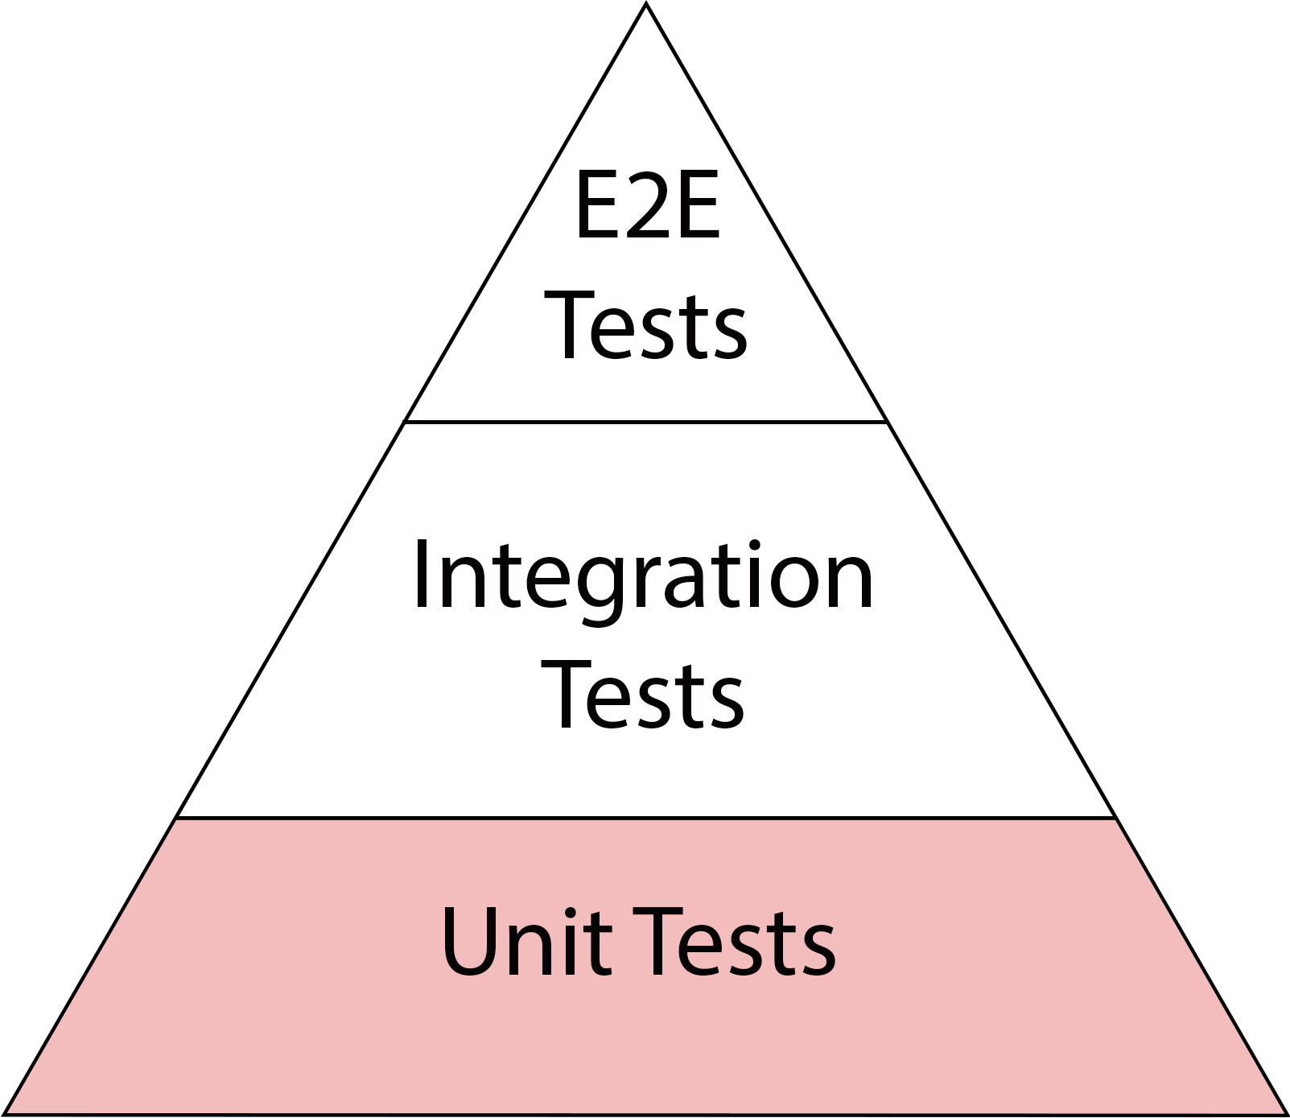
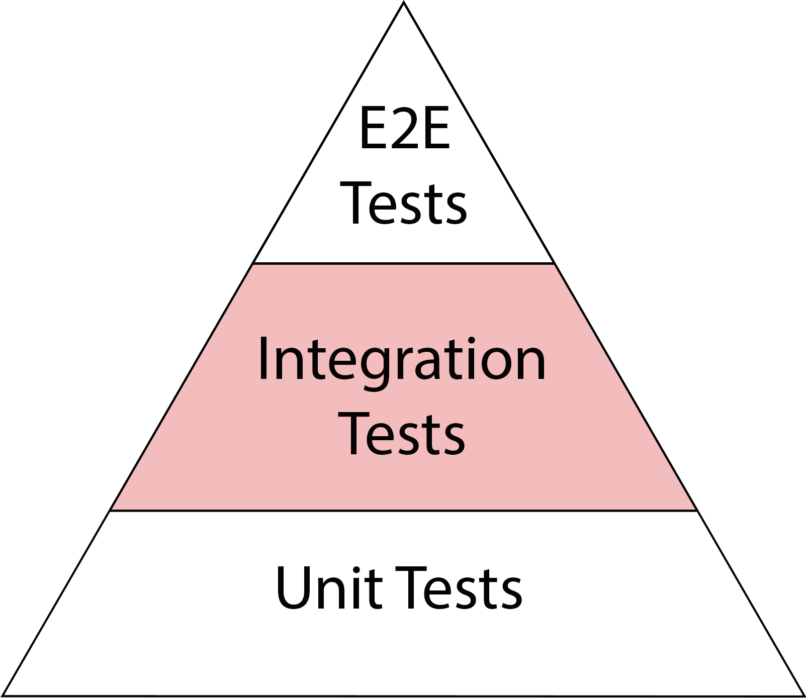
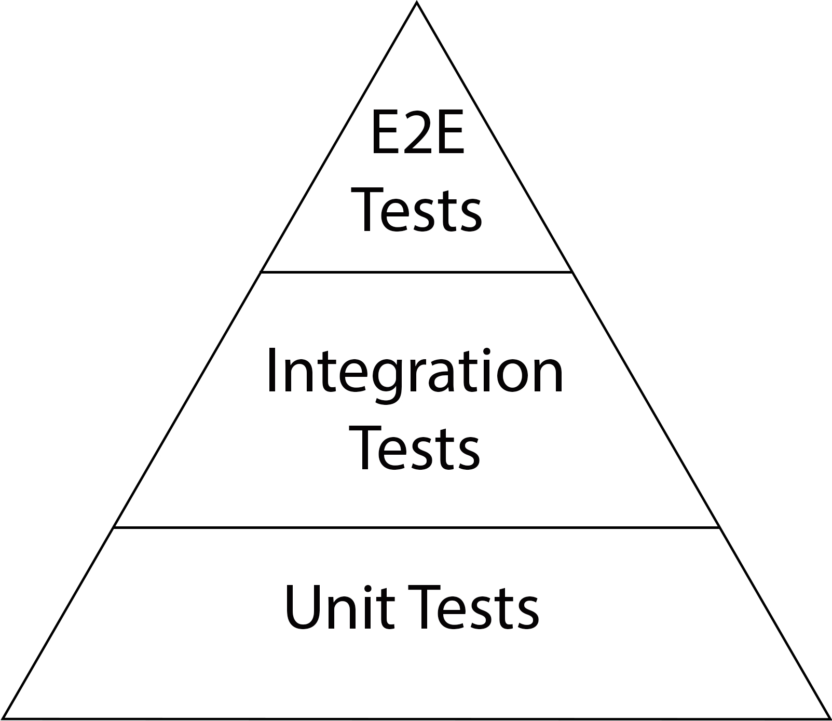
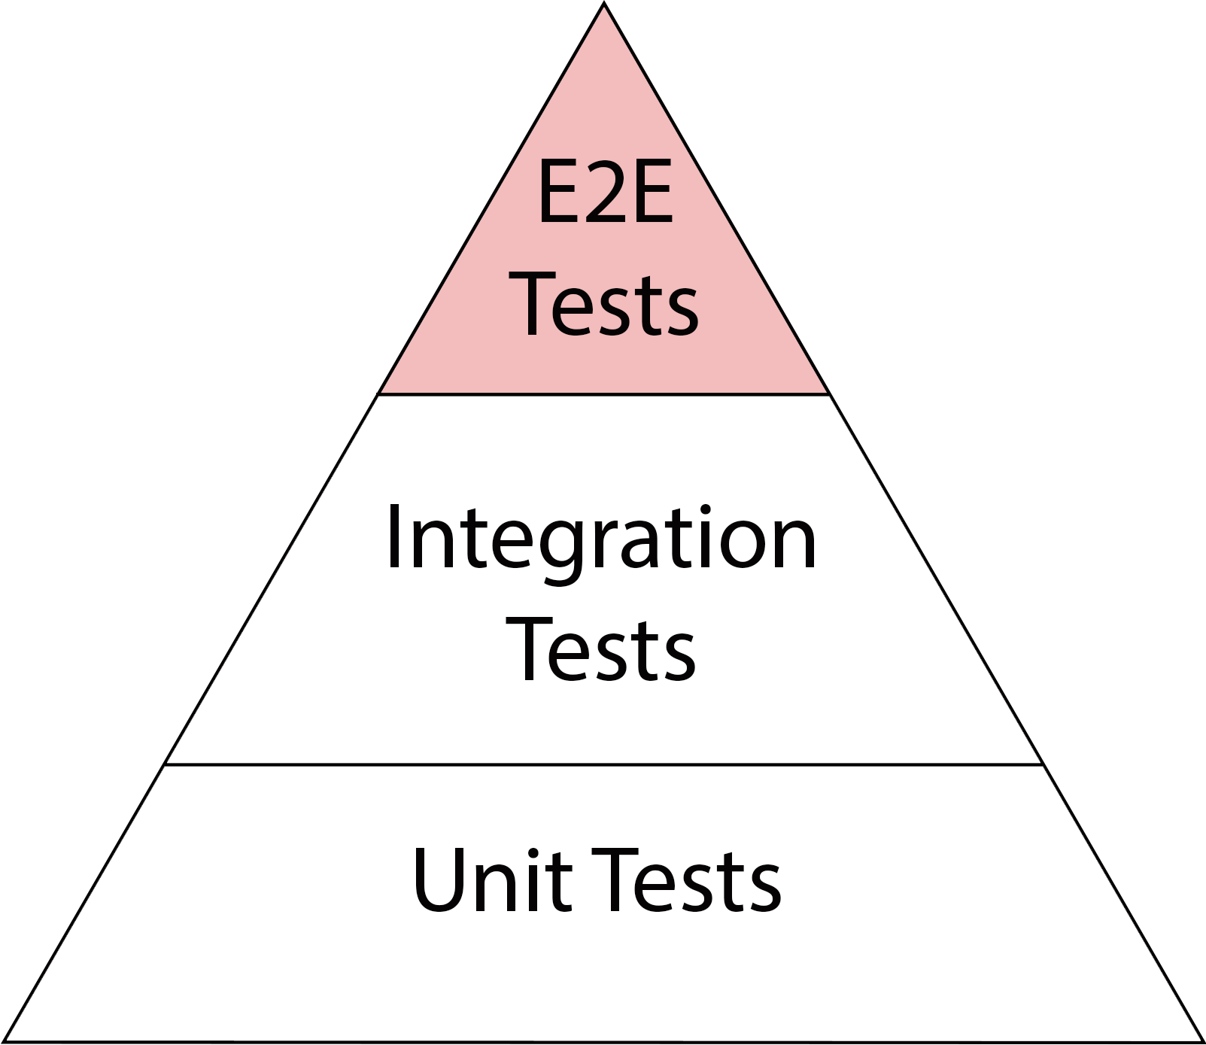
Test Pyramid
↑ Fidelity
↓ Speed
↑ Cost
↓ Fidelity
↑ Speed
↓ Cost
Notes:
Explain width is #tests

Slide 5
What is this “something”?
Let’s test something!

Slide 6
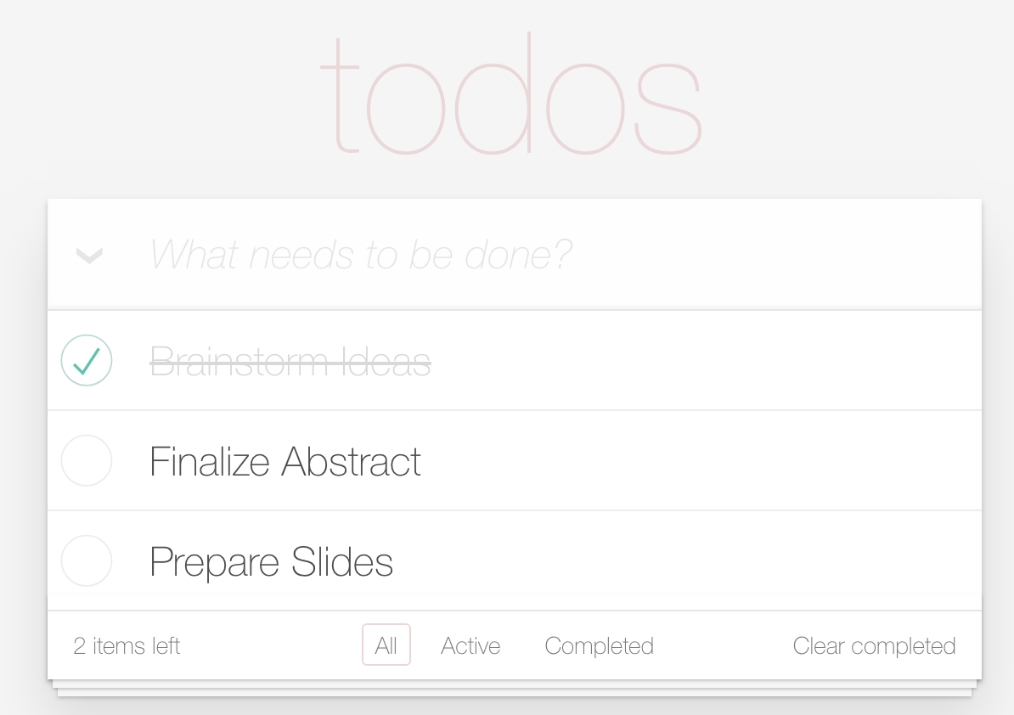
Example App
Notes:
Show the app: http://todomvc.com/examples/angularjs/#/

Slide 7
Back to testing!
Notes:
Show the app

Slide 8
End-to-End Testing
Today’s Focus

Slide 9
Common way to do E2E?

Slide 10
Selenium WebDriver
Defacto E2E Tool
Testing
Standard
Generic
↑ Integrations

Slide 11
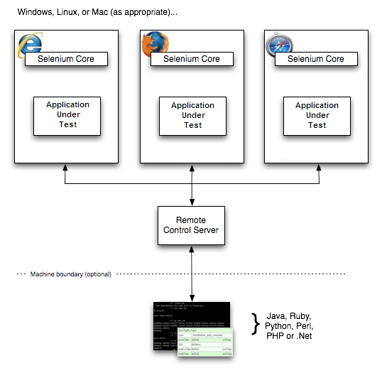
Selenium WebDriver
Selenium WebDriver
From “SeleniumHQ, Selenium RC”
Notes:
Reference: https://www.seleniumhq.org/docs/05_selenium_rc.jsp

Slide 12
Case #1
Backend:
Java
Testing:
Java

Slide 13
Is there a problem?
Yes, there is

Slide 14
Why not Server Side Test?
Hybrid Model
DDD
DDD
User Centric
User Centric

Slide 15
Hybrid Model
Software
Engineers
Software Principles
Testing Expertise

Slide 16
Why not Server Side Test?
Hybrid Model
Hybrid Model
DDD
DDD
DDD
User Centric

Slide 17
Domain Driven Design
Ubiquitous Language
Context Matters

Slide 18
Why not Server Side Test?
Hybrid Model
Hybrid Model
DDD
DDD
DDD
DDD
User Centric
User Centric

Slide 19
Still not convinced?

Slide 20
Modern Web Testing

Slide 21
Power of JavaScript
Assertion Libraries
Chai
Jasmine
Process Libraries
Process Libraries
Process Libraries
BDD
Libraries
Cucumber
Enterprise Libraries
Enterprise Libraries
Enterprise Libraries
Applitools

Slide 22
Speaking Language
of the Web
JavaScript
Node.js

Slide 23
Node.js
Isomorphic
Flexible
Customizable
NPM Manager
Notes:
Indeed open source

Slide 24
Going back to the Pyramid
Established Medium

Slide 25
Test Pyramid
↓ Fidelity
↑ Speed
↓ Cost
Notes:
Karma

Slide 26
Unit Testing
In Web Context

Slide 27
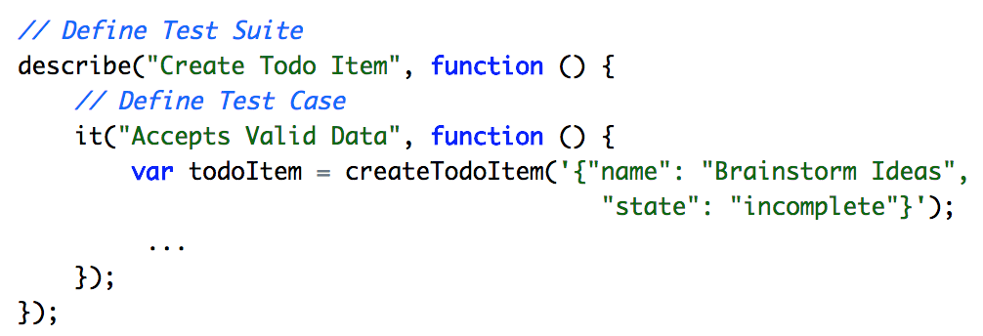
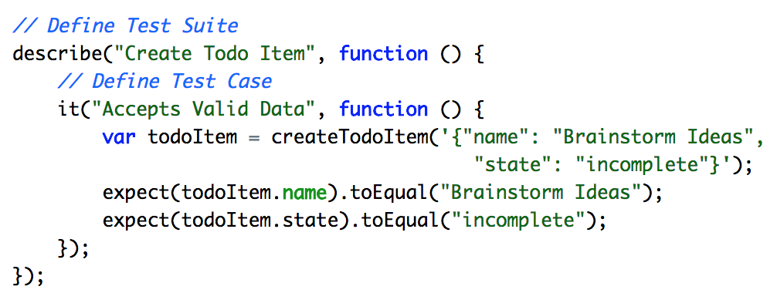
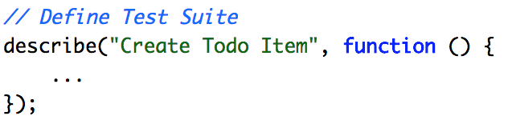
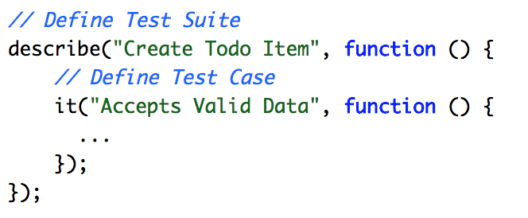
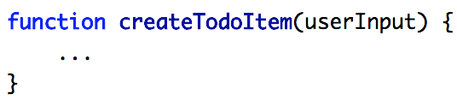
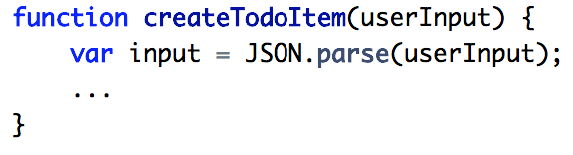
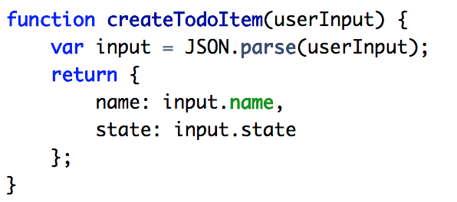
Example: Jasmine

Slide 28
Test Pyramid
↓ Fidelity
↑ Speed
↓ Cost
Notes:
Jest,
Jasmine - components

Slide 29
Integration Testing
In Web Context

Slide 30
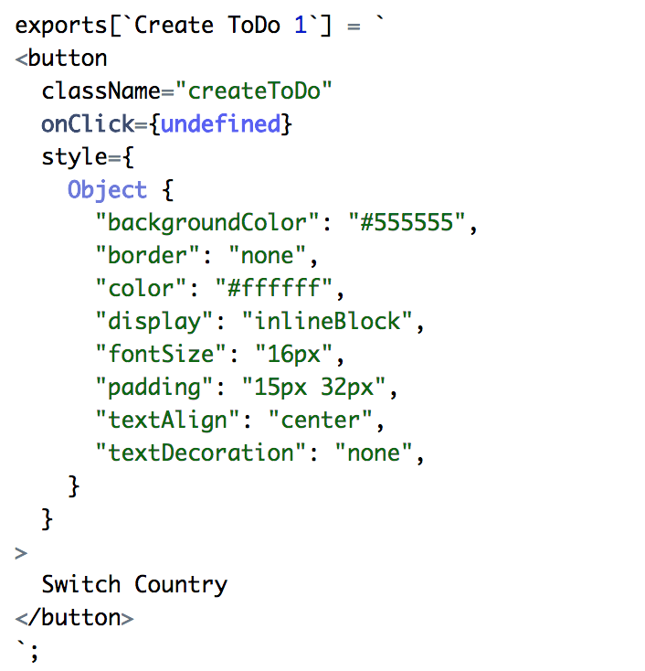
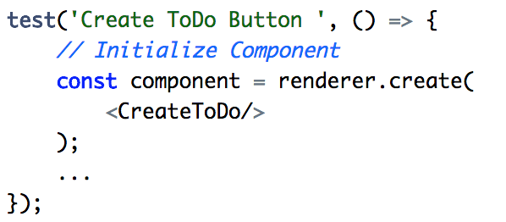
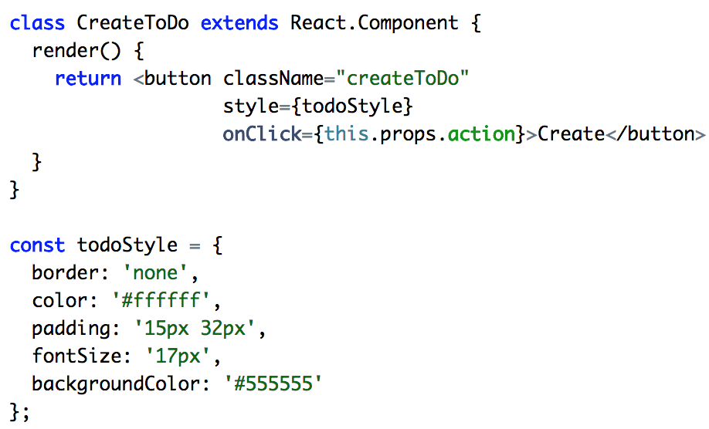
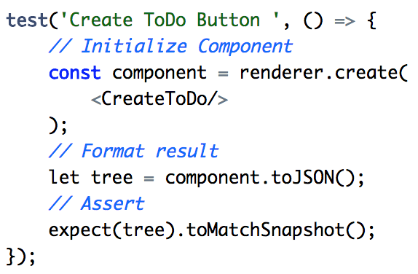
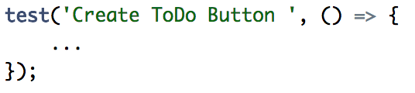
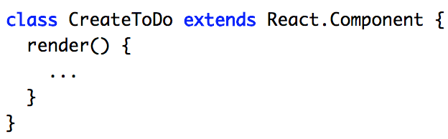
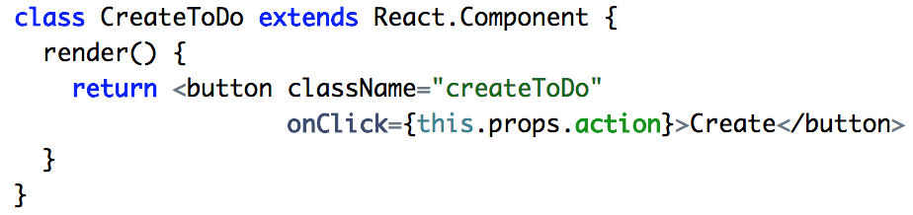
Example: Jest

Slide 31
Let’s reflect on it

Slide 32
Test Pyramid
↓ Fidelity
↑ Speed
↓ Cost
Notes:
Explain width is #tests

Slide 33
Every step has
only 1 focus
Developers
Notes:
Reinforce the idea that Tests are about feedback, about communication

Slide 34
Good for some tests
But not for E2E tests

Slide 35
Test Pyramid
↑ Fidelity
↓ Speed
↑ Cost
↓ Fidelity
↑ Speed
↓ Cost
Notes:
Explain width is #tests

Slide 36
Shifting focus
Developers
Customers

Slide 37
Sounds great!
But how do we do it?

Slide 38
End-to-End Task Testing
User Centric Testing
Interactions
Tasks
Page Object Model
Screenplay Pattern
Notes:
Possibly talk about screenplay vs interation, explain why task
SOLID pattern

Slide 39
No!
Should we use
Java for tests?
Back to our app

Slide 40
What should we do?
Move to Client Side
Notes:
Web app context, web rules - write tests on the client side

Slide 41
Continuing with Selenium
WebdriverJs
Notes:
Very important “Js”, not “JS”

Slide 42
WebdriverJs
Selenium WebDriver
Defacto E2E Tool
Testing
Standard
Generic
↑ Integrations

Slide 43
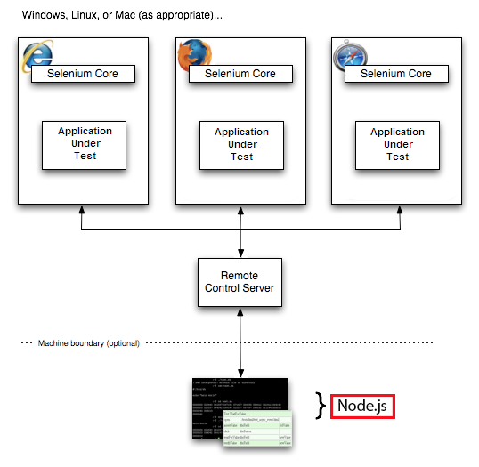
Selenium WebdriverJs
Selenium WebdriverJs
From “SeleniumHQ, Selenium RC”
Notes:
Reference: https://www.seleniumhq.org/docs/05_selenium_rc.jsp

Slide 44
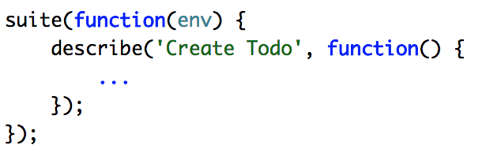
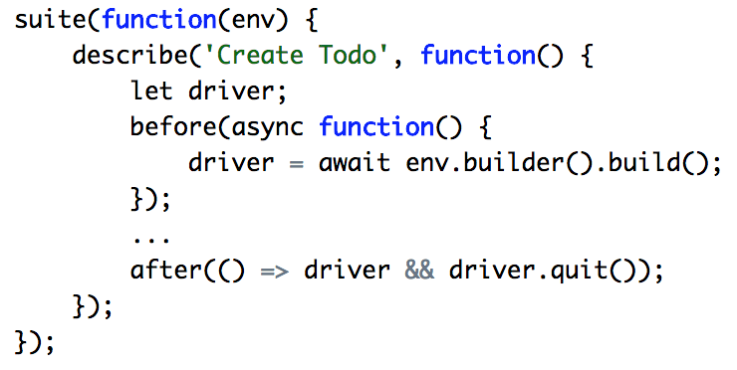
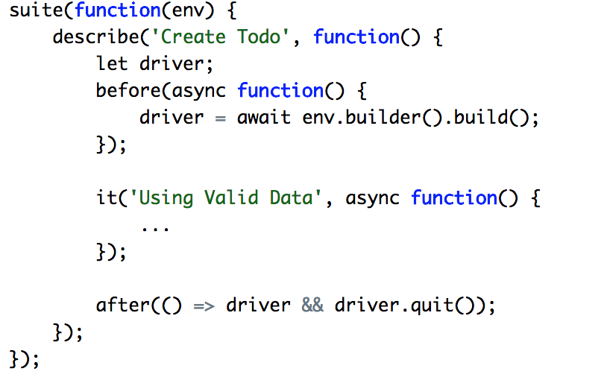
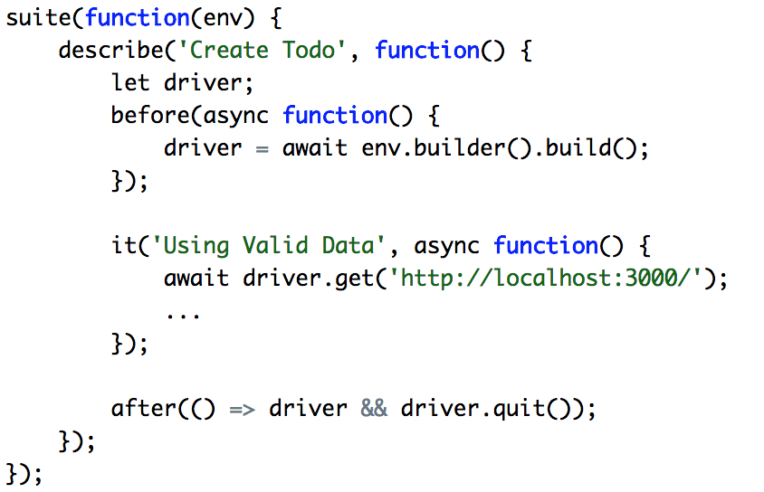
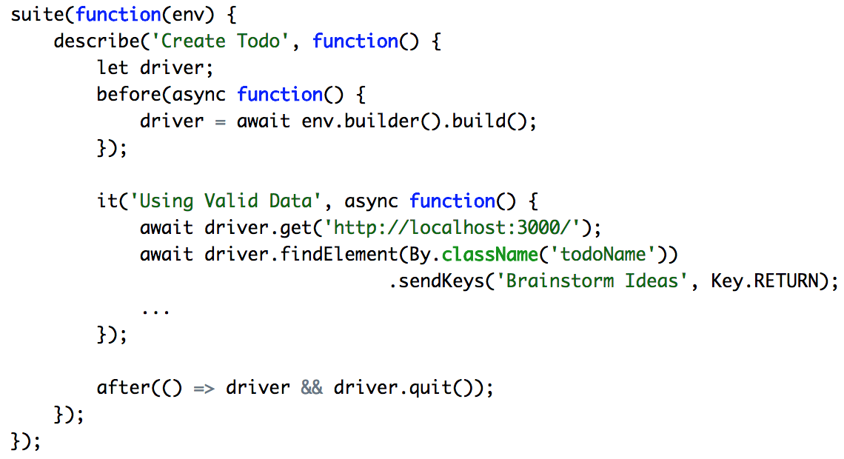
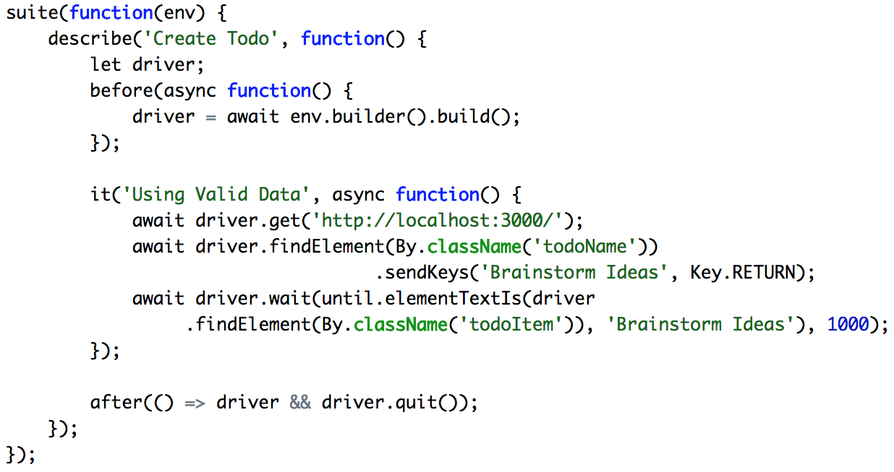
Example: WebdriverJs
Notes:
ES6
Mocha

Slide 45
Only good parts, right?
Not Really...

Slide 46
E2E Tests:
General Complexity
Selectors
Locator Strategy
Test Flows
SPA Types

Slide 47
What about WebdriverJs?

Slide 48
E2E Tests:
General Complexity
Selectors
ID, CSS,
Xpath
Locator Strategy
Locator Strategy
Locator Strategy
By Locators
WebdriverJs
Test Flows
Test Flows
Test Flows
Promise Manager
SPA Types
SPA Types
SPA Types
SPA Types
SPA Types
Generic

Slide 49
Looks limited
Is there anything better?

Slide 50
Remember our test app?
Case #2
Models
Controllers
Angular
Components
Notes:
Focus on SPA

Slide 51
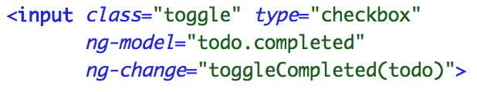
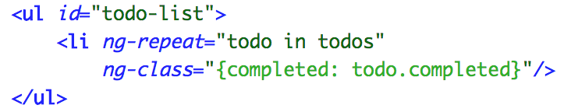
Demo App: Closer Look

Slide 52
How would we test that?

Slide 53
Test Pyramid
↑ Fidelity
↓ Speed
↑ Cost
↓ Fidelity
↑ Speed
↓ Cost
Notes:
Explain width is #tests

Slide 54
Do we have to use WebdriverJs?
No!

Slide 55
Protractor
E2E Test Framework for Angular Apps

Slide 56
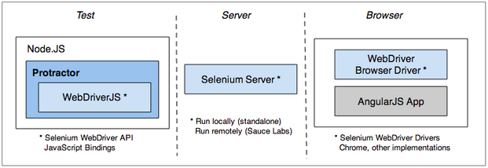
Protractor
Protractor
From “Protractor.org”
Notes:
https://www.protractortest.org/#/infrastructure

Slide 57
E2E Tests:
General Complexity
Selectors
Element Bindings
Locator Strategy
Locator Strategy
Locator Strategy
By Repeaters
Protractor
Test Flows
Test Flows
Test Flows
Application State Aware
SPA Types
SPA Types
SPA Types
Angular Oriented

Slide 58
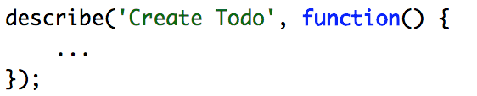
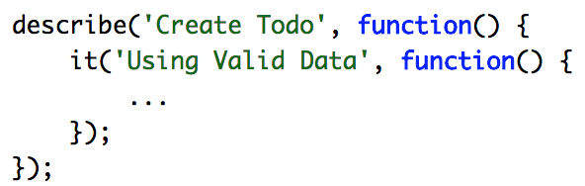
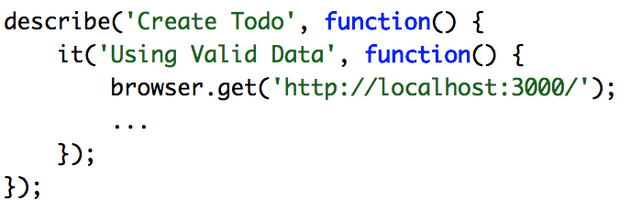
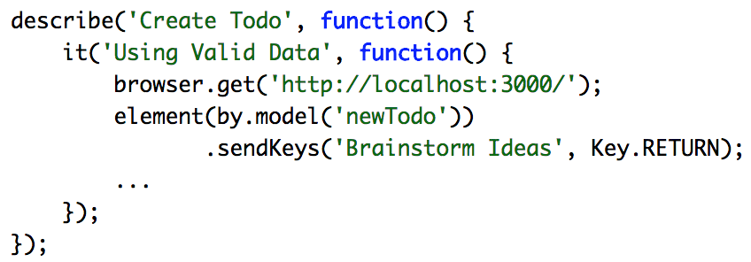
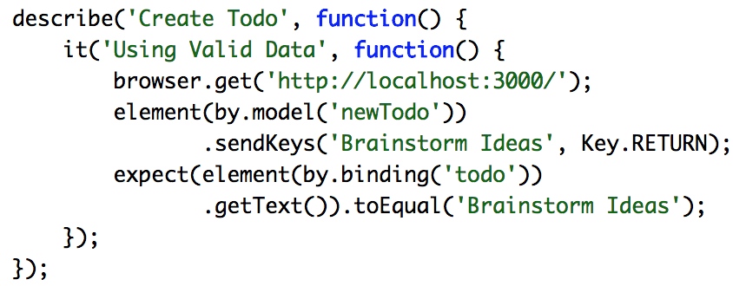
Example: Protractor
Notes:
Jasmine

Slide 59
Angular is great
But

Slide 60
There are Many More Front-End Frameworks...
React
Vue
Ember
Backbone

Slide 61
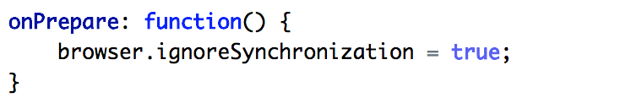
Protractor + React
Protractor + React

Slide 62
Protractor + React
Conclusion

Slide 63
What’s Next?
Non-Selenium
UI Test Frameworks
TestCafe
Cypress.io

Slide 64
Patterns.
Patterns everywhere
What have we
learned so far?
Handling Waits
Parallel Execution
RTD
Recorder
& IDE
Notes:
Injects scripts directly into DOM

Slide 65
Non-Selenium
UI Test Frameworks
TestCafe
Cypress.io
Cypress.io

Slide 66
Common Patterns
TestCafe
Handling Waits
Parallel Execution
RTD
Recorder
& IDE
Notes:
https://github.com/DevExpress/testcafe
https://github.com/DevExpress/testcafe-live

Slide 67
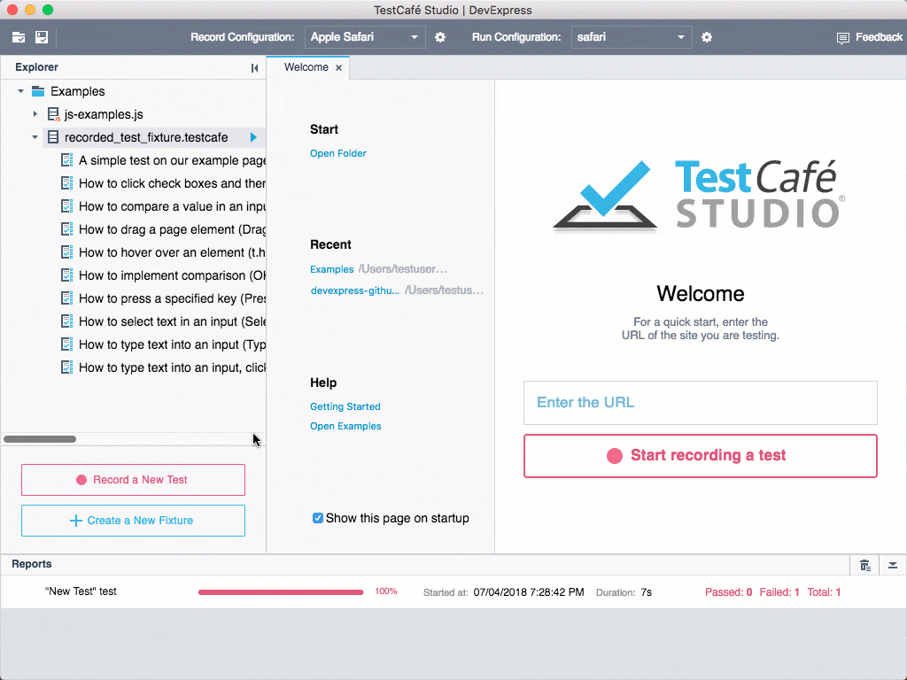
TestCafe: Recorder & IDE
Recorder & IDE
Source:
TestCafe by DevExpress, https://github.com/DevExpress/testcafe

Slide 68
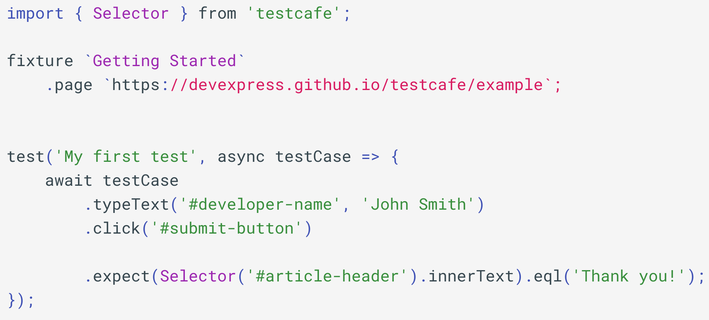
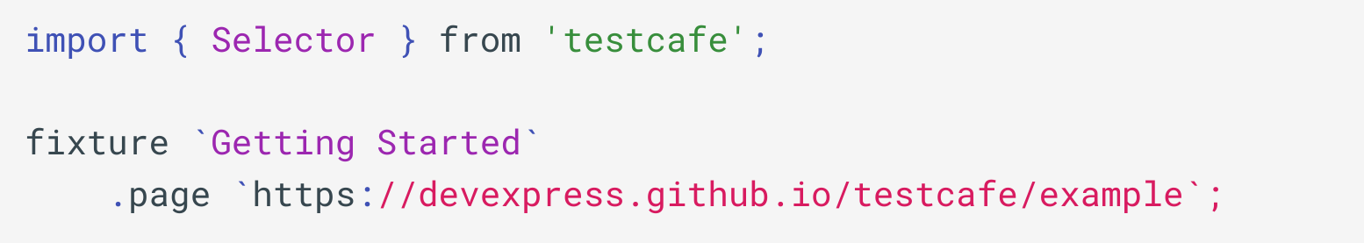
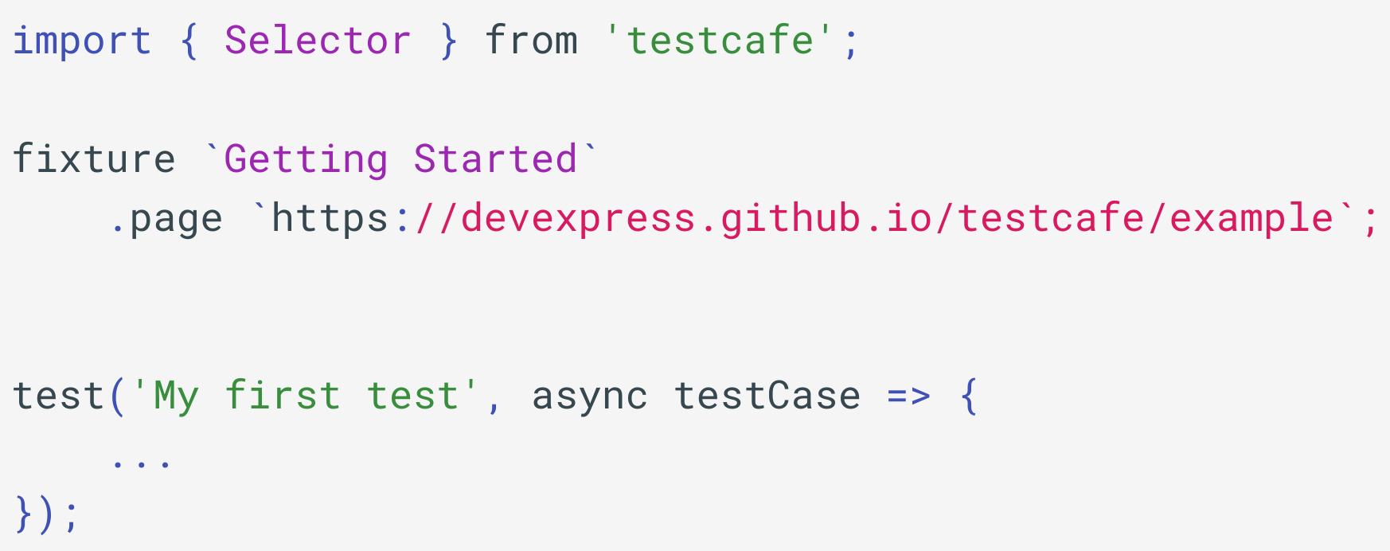
TestCafe: Example
TestCafe: Example
Source:
TestCafe by DevExpress, https://github.com/DevExpress/testcafe
Notes:
https://github.com/DevExpress/testcafe
https://github.com/DevExpress/testcafe-live
https://testcafe-studio.devexpress.com

Slide 69
Non-Selenium
UI Test Frameworks
TestCafe
TestCafe
Cypress.io
Cypress.io
Cypress.io

Slide 70
Common Patterns
Cypress.io
Handling Waits
Parallel Execution
RTD
Recorder
& IDE
Notes:
https://www.cypress.io

Slide 71
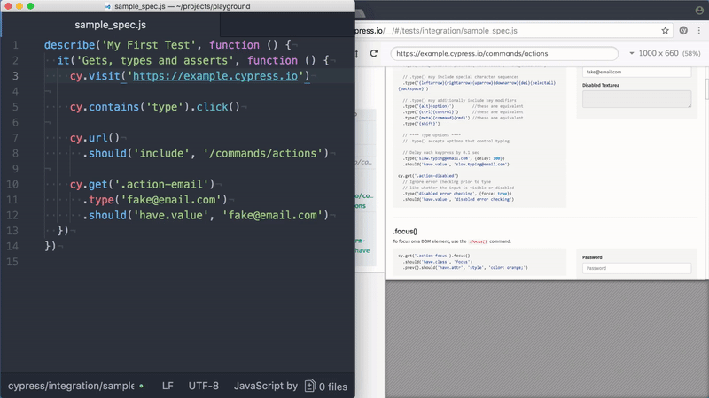
Cypress.io: Reports & IDE
Source:
Cypress.io Example by Cypress.io, https://www.cypress.io

Slide 72
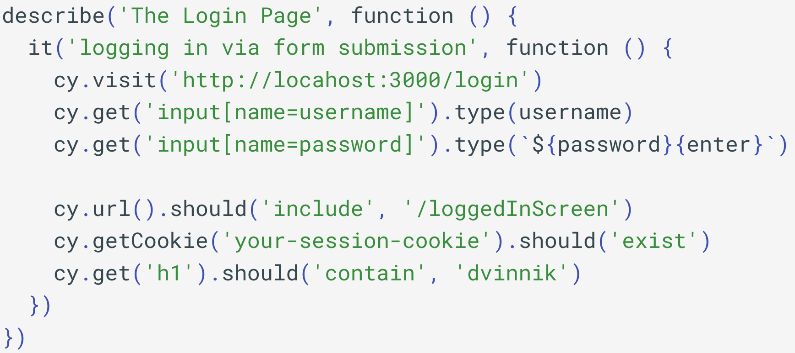
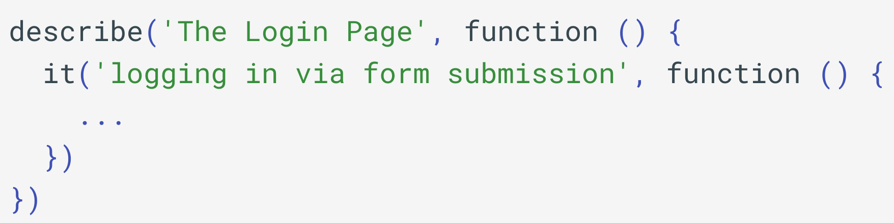
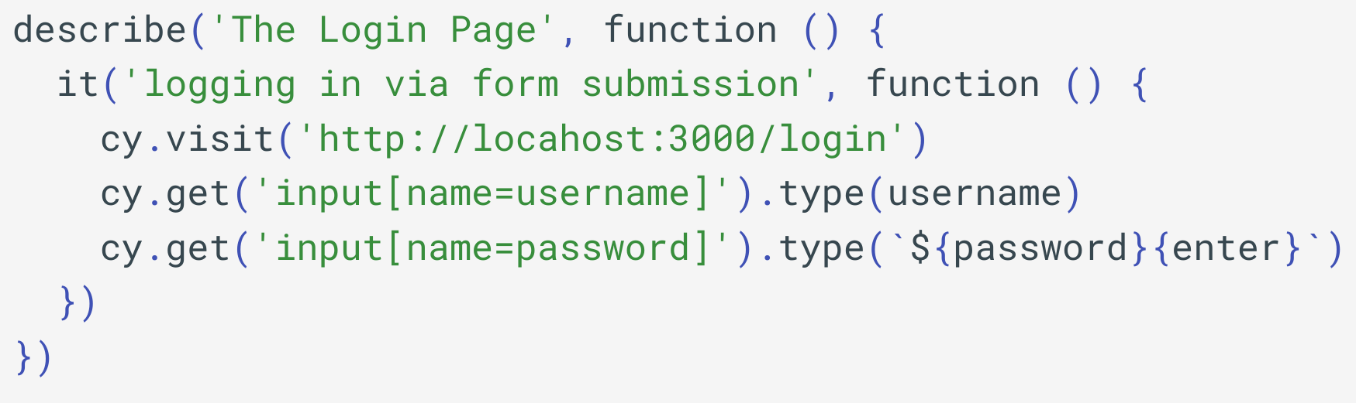
Cypress.io: Example
Cypress.io: Example
Source:
Basic Example by Cypress.io, https://www.cypress.io
Notes:
Extensive documentation - https://docs.cypress.io

Slide 73
Right Tool for the Right Problem

Slide 74
There are many other
E2E Test Frameworks
WebdriverIO
Nightwatch.js
WD
Nemo

Slide 75
Avoid Tool Mixups
↑ Complexity
No DDD
No Common Language

Slide 76
How to Choose?
Github Stars
NPM Downloads
External Integrations
POC
Notes:
We exist in a land of options

Slide 77
But More Importantly
Flexibility
Use Case
Use Case

Slide 78
Flexibility
Cost of Transition
ROI
Ability to Customize
Ability to Replace
Notes:
Compare to Kotlin/Scala transition cost, ROI

Slide 79
But More Importantly
Flexibility
Flexibility
Use Case
Use Case
Use Case

Slide 80
Use Case
Team Expertise
Application Framework
Test Infrastructure

Slide 81
Call For Action
Evaluate Test Architecture
Have Domain Boundaries
Unify Test Strategy
Experiment!
Notes:
Will be sharing slides, github and useful links

Slide 82
Q/A

Slide 83
About Speaker
Twitter: @DmitryVinnik
LinkedIn: in/dmitry-vinnik/
Email: dmitry@dvinnik.com

